Slide 1
Navigating pH Levels with Classifier Models: The Role of Crude Ratios in IOW (Integrity Operating Windows) By TEM & R-PI

Slide 2
Problem Statement

Slide 3
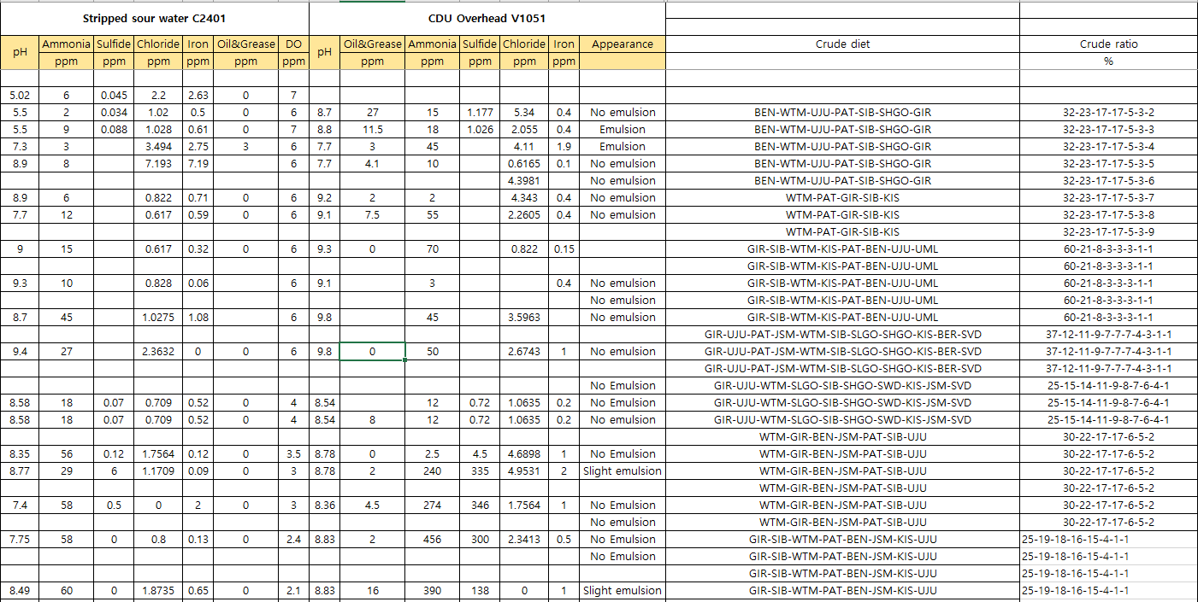
Data Preprocessing
Columns that we are interested in:
pH (C2401)
Ammonia (C2401)
Sulfide (C2401)
Chloride (C2401)
Crude diet
Crude ratio

Slide 4
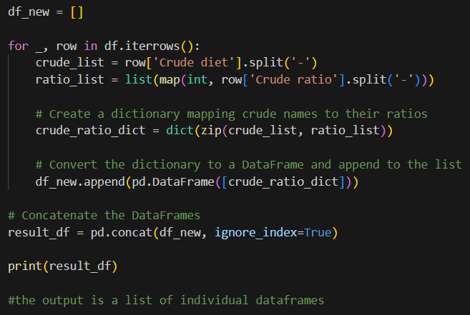



Data Preprocessing
Step1: Remove unneeded data (columns/rows)
Step2: Create new columns for each crude name and ratio
Mapping crude name and ratio
Step3: Specify Pass/No-Pass pH value
Step4: Identify X (parameters of interest) and Y (value we want the model to classify)

Slide 5

Machine Learning – Gradient Boosting Classifier
Train
Dataset
80%
Compare predicted Y and actual Y
Dataset
Model predicts on test dataset
Classifier Model
140 rows
39 columns
Test
Dataset
20%

Slide 6
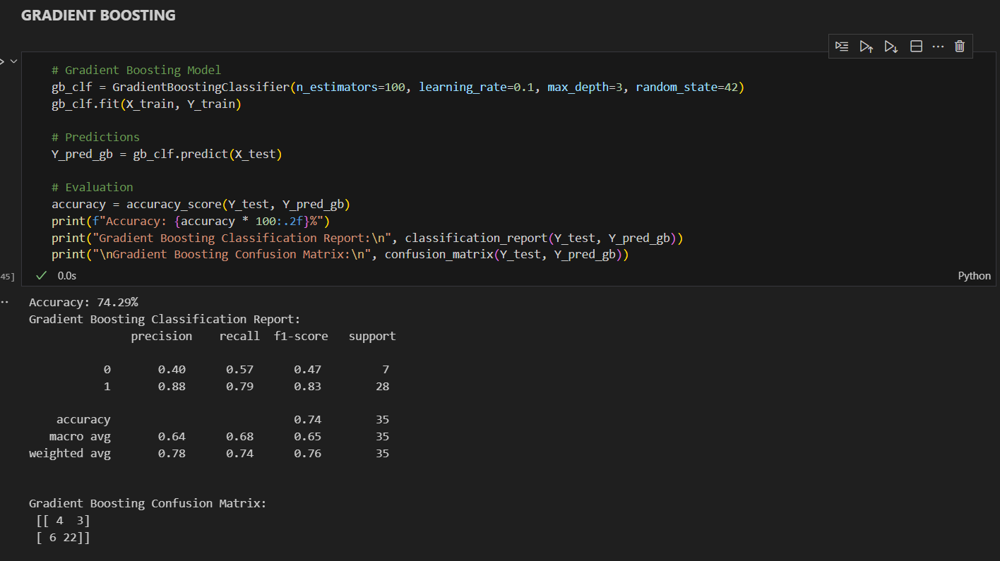
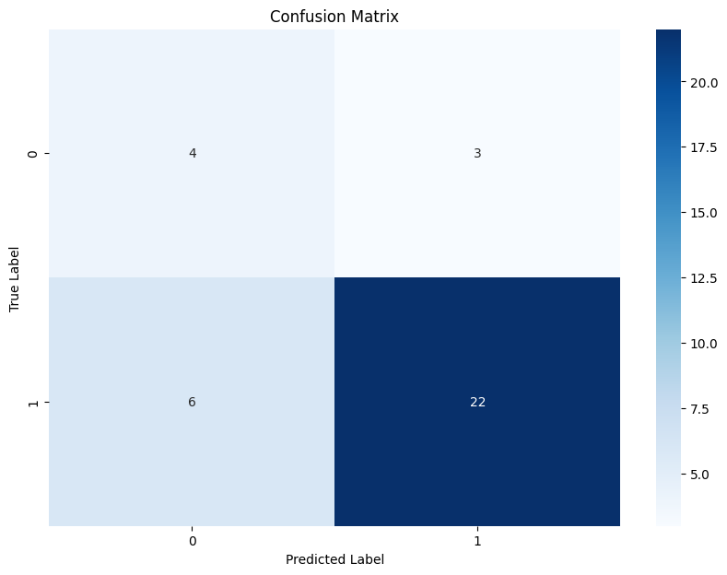
Machine Learning – Gradient Boosting Classifier
Accuracy: 74.29%
Recall for 0 (out of IOW): 57%

Slide 7
Next Actions
Get more data (past two years or more) for training
Get new data for testing
Create validation set
Improve the model (especially recall) by possible alternatives
Tuning hyperparameters
Resampling
Study if this use case can be upgraded to prediction of pH value

Slide 8
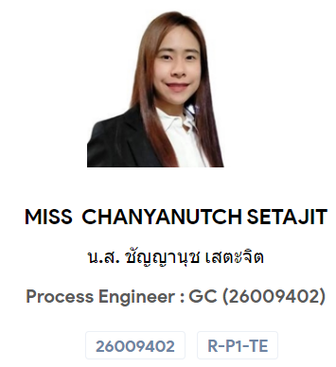



Thank you

